Slide 1

About the Presentations
The presentations cover the objectives found in the opening of each chapter.
All chapter objectives are listed in the beginning of each presentation.
You may customize the presentations to fit your class needs.
Some figures from the chapters are included. A complete set of images from the book can be found on the Instructor Resources disc.

Slide 2
Oracle 11g: SQL
Chapter 4
Constraints

Slide 3
Objectives
Explain the purpose of constraints in a table
Distinguish among PRIMARY KEY, FOREIGN KEY, UNIQUE, CHECK, and NOT NULL constraints and the appropriate use for each constraint
Understand how constraints can be created when creating a table or modifying an existing table
Distinguish between creating constraints at the column level and table level
Oracle 11g: SQL

Slide 4
Objectives (continued)
Create PRIMARY KEY constraints for a single column and a composite primary key
Create a FOREIGN KEY constraint
Create a UNIQUE constraint
Create a CHECK constraint
Oracle 11g: SQL

Slide 5
Objectives (continued)
Create a NOT NULL constraint using the ALTER TABLE…MODIFY command
Include constraints during table creation
Use DISABLE and ENABLE commands
Use the DROP command
Oracle 11g: SQL

Slide 6
Constraints
Rules used to enforce business rules, practices, and policies
Rules used to ensure accuracy and integrity of data
Oracle 11g: SQL

Slide 7
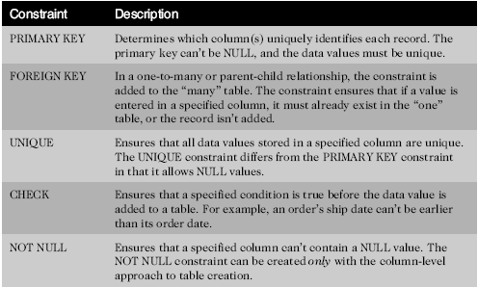
Constraint Types
Oracle 11g: SQL

Slide 8
Creating Constraints
Use the optional CONSTRAINT keyword during creation to assign a name
Let the server name the constraint using the default format SYS_Cn
Informative names can assist in debugging
Oracle 11g: SQL

Slide 9
Creating Constraints (continued)
When
  During table creation
  After table creation, by modifying the existing table
How
  Column level approach
  Table level approach
Oracle 11g: SQL

Slide 10
Creating Constraints at the Column Level
If a constraint is being created at the column level, the constraint applies to the column specified
Oracle 11g: SQL

Slide 11
Creating Constraints at the Table Level
Approach can be used to create any constraint type except NOT NULL
Required if constraint is based on multiple columns
Oracle 11g: SQL

Slide 12
Enforcement of Constraints
All constraints are enforced at the table level
If a data value violates a constraint, the entire row is rejected
Oracle 11g: SQL

Slide 13
Adding Constraints to Existing Tables
Constraints are added to an existing table with the ALTER TABLE command
Add a NOT NULL constraint using MODIFY clause
All other constraints are added using ADD clause
Oracle 11g: SQL

Slide 14
Using the PRIMARY KEY Constraint
Ensures that columns do not contain duplicate or NULL values
Only one per table is allowed
Oracle 11g: SQL

Slide 15
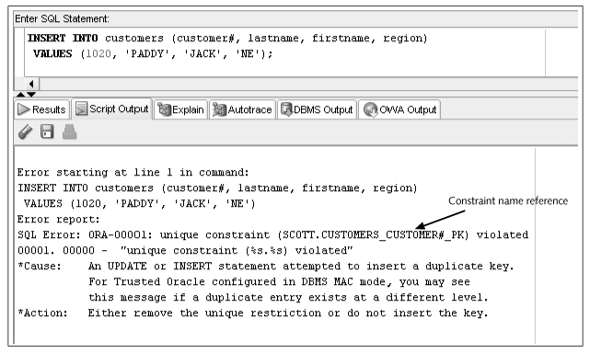
Constraint Checked with Data Input
Oracle 11g: SQL

Slide 16
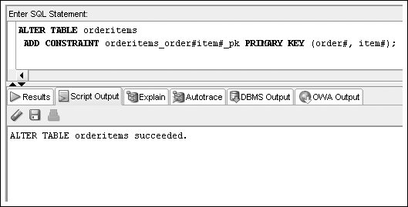
PRIMARY KEY Constraint for Composite Key
List column names within parentheses separated by commas
Oracle 11g: SQL

Slide 17
Using the FOREIGN KEY Constraint
Requires a value to exist in the referenced column of another table
NULL values are allowed
Enforces referential integrity
Maps to the PRIMARY KEY in parent table
Oracle 11g: SQL

Slide 18
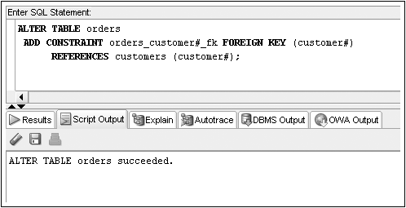
FOREIGN KEY Constraint Example
Oracle 11g: SQL

Slide 19
Deletion of Foreign Key Values
You cannot delete a value in a parent table referenced by a row in a child table
Use ON DELETE CASCADE keywords when creating FOREIGN KEY constraint – it automatically deletes a parent row when the row in a child table is deleted
Oracle 11g: SQL

Slide 20
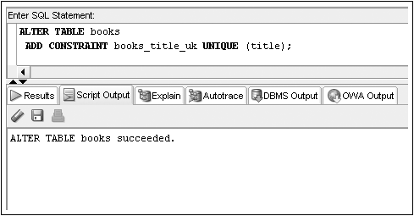
Using the UNIQUE Constraint
No duplicates are allowed in the referenced column
NULL values are permitted
Oracle 11g: SQL

Slide 21
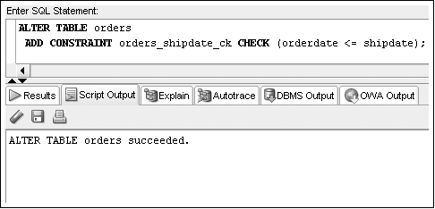
Using the CHECK Constraint
Updates and additions must meet specified condition
Oracle 11g: SQL

Slide 22
Using the NOT NULL Constraint
The NOT NULL constraint is a special CHECK constraint with IS NOT NULL condition
Can only be created at column level
Included in output of DESCRIBE command
Can only be added to an existing table using ALTER TABLE…MODIFY command
Oracle 11g: SQL

Slide 23
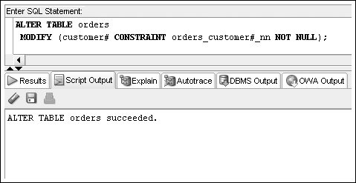
NOT NULL Constraint Example
Oracle 11g: SQL

Slide 24

Including Constraints during Table Creation – Column Level
Include in column definition
Oracle 11g: SQL

Slide 25
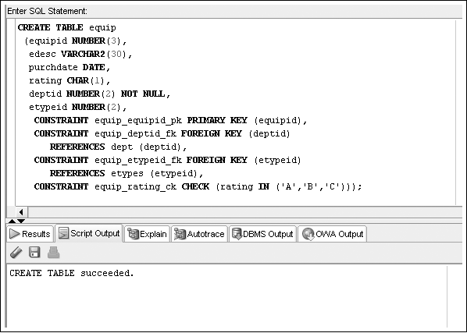
Including Constraints during Table Creation – Table Level
Include at end of column list
Oracle 11g: SQL

Slide 26
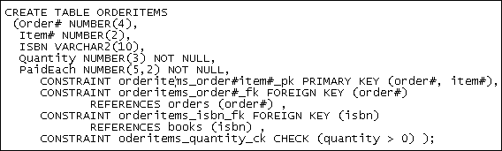
Multiple Constraints on a Single Column
A column may be included in multiple constraints
The order# column is included in a primary key and a foreign key constraint
Oracle 11g: SQL

Slide 27
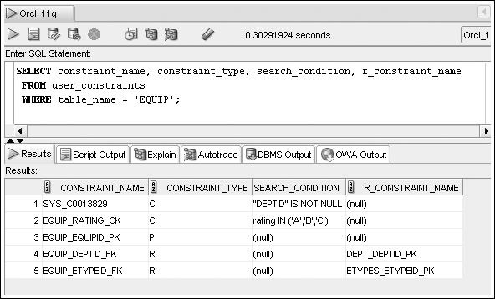
Viewing Constraints – USER_CONSTRAINTS
Display constraint listing for a specific table
Oracle 11g: SQL

Slide 28
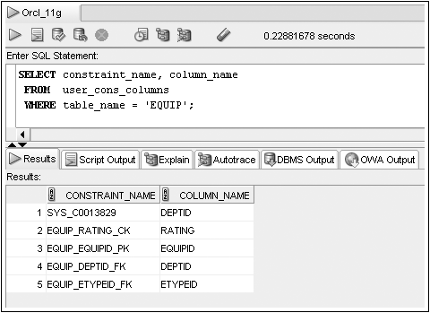
Viewing Constraints – USER_CONS_COLUMNS
Display constraint listing by column
Oracle 11g: SQL

Slide 29
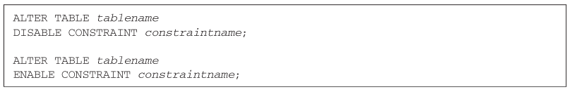
Using DISABLE/ENABLE
Use DISABLE or ENABLE clause of ALTER TABLE command
Oracle 11g: SQL

Slide 30
Dropping Constraints
Constraints cannot be modified; they must be dropped and recreated
Actual syntax depends on type of constraint
  PRIMARY KEY – just list type of constraint
  UNIQUE – include column name
  All others – reference constraint name
Oracle 11g: SQL

Slide 31

ALTER TABLE…DROP Syntax
Oracle 11g: SQL

Slide 32
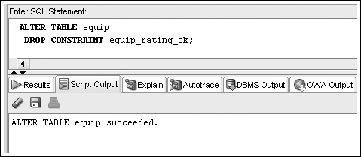
Drop Constraint Example
Oracle 11g: SQL

Slide 33
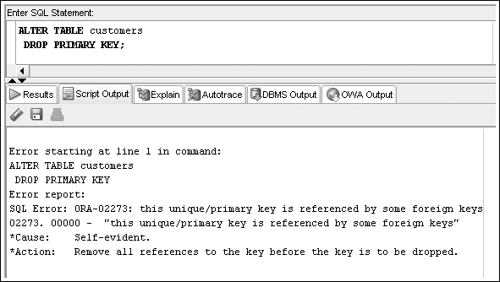
Drop Constraint Example – Error
Oracle 11g: SQL

Slide 34
Summary
A constraint is a rule that is applied to data being added to a table
  The constraint represents business rules, policies, and/or procedures
  Data violating the constraint is not added to the table
A constraint can be included during table creation as part of the CREATE TABLE command or added to an existing table using the ALTER TABLE command
Oracle 11g: SQL

Slide 35
Summary (continued)
A PRIMARY KEY constraint does not allow duplicate or NULL values in the designated column
Only one PRIMARY KEY constraint is allowed in a table
A FOREIGN KEY constraint requires that the column entry match a referenced column entry in the referenced table or be NULL
A UNIQUE constraint is similar to a PRIMARY KEY constraint except it allows NULL values to be stored in the specified column
A CHECK constraint ensures a value meets a specified condition
Oracle 11g: SQL

Slide 36
Summary (continued)
A NOT NULL constraint ensures a value is provided for a column
A constraint can be disabled or enabled using the ALTER TABLE command and the DISABLE and ENABLE keywords
A constraint cannot be modified
  To change a constraint, the constraint must first be dropped with the DROP command and then re-created
USER_CONSTRAINTS and USER_CONS_COLUMNS data dictionary views provide information regarding constraints
Oracle 11g: SQL

